Slide 1




AI-Based Energy Consumption Prediction and Optimization System
Team Members:
Gangotri Datta Kompalwar
Prathmesh Raju Gavhane
Shubham Joshi
Rohit sonar
Prof. Sarthak Narnor
College Name - MIT ACADEMY OF ENGINEERING

Slide 2

Project Outline
Problem Statement and Objectives
Project Overview – Introduction
Dataset and Model Details
End Users
Wow Factor in Project
Modelling/Block Diagram/Flow of Project (Flowchart)
Result/outcomes
Conclusion
Future Perspective
Reference (Datalink, Github, Anyother websites)

Slide 3
Problem Statement and Objectives
Problem statement:
In today’s world, energy consumption is increasing rapidly due to population growth, urbanization, and industrial expansion. However, most traditional energy management systems are inefficient, reactive, and lack predictive capabilities. They do not analyze past data effectively or provide intelligent recommendations to optimize energy usage.
This project aims to solve these problems using Artificial Intelligence techniques from Machine Learning and Deep Learning to build a smart and efficient energy management system.
Objective:
To predict future energy consumption using AI models
To analyze historical energy usage patterns
To optimize energy consumption and reduce wastage
To minimize electricity cost
To identify peak energy usage periods
To provide smart recommendations for efficient usage
To develop a user-friendly monitoring dashboard

Slide 4
Project Overview - Introduction
The AI-Based Energy Consumption Prediction and Optimization System is designed to address this challenge by using advanced techniques from Machine Learning and Deep Learning. The system analyzes historical energy consumption data along with external factors such as time and weather conditions to predict future energy usage accurately.
⚡ The Problem
Energy is wasted daily due to poor management
No system to predict future consumption
High electricity bills & peak load issues
🔍 What This System Does
📊 Analyzes past energy usage
🔮 Predicts future consumption
⚙️ Optimizes electricity usage automatically
💬 Suggests smart energy-saving actions
🌱 Impact
Reduce electricity bills
Improve energy efficiency
Support sustainable environment
🤖 The Idea
Build an intelligent system using
Machine Learning + Deep Learning
to make energy usage smart and efficient
🚀 Why This Project is Unique
Combines AI + Energy Management
Works like a “Smart Energy Assistant”
Can be used in homes, industries & smart cities

Slide 5
Dataset and Model Details
Dataset Details
The dataset consists of energy consumption data for two buildings:
Building A dataset
Building B dataset
Data is recorded hourly (time-series data)
🔹 Features in Dataset:
DATE : Timestamp (date & time)
ENERGY : Energy consumption (target variable)
HDD (Heating Degree Days) : Heating requirement indicator
CDD (Cooling Degree Days) : Cooling requirement indicator
T2M / T2M_MIN / T2M_MAX : Temperature values
ALLSKY → Solar radiation / sky condition
HOLIDAY → Indicates holiday (0/1)
2. Data Preprocessing
Handled missing values (NaN in ENERGY column)
Converted DATE column → datetime format
Normalized / scaled numerical features
Removed unnecessary or redundant columns
Split data into:
Training set
Testing set

Slide 6
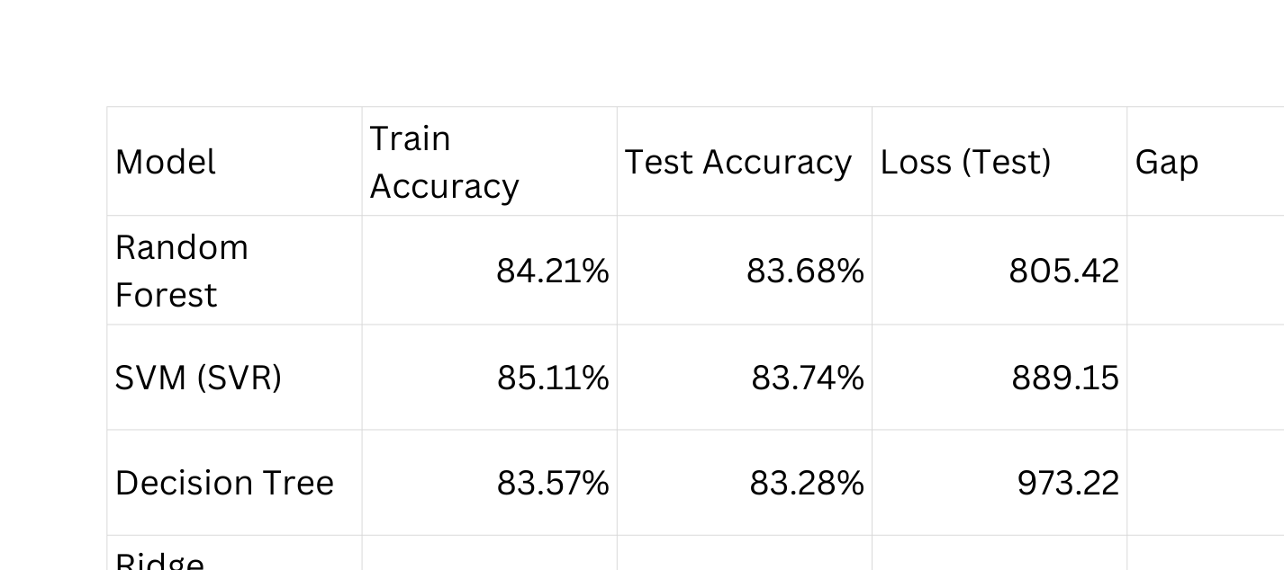
Dataset and Model Details
Model Details (👉 SVM (SVR) achieved the highest test accuracy:
Test Accuracy = 83.74%

Slide 7
End Users
👤 1. Residential Users (Smart Homes)
Homeowners using smart devices
Want to reduce electricity bills
Monitor daily energy usage
🏢 2. Commercial Buildings
Offices, malls, hotels
Manage large-scale energy consumption
Optimize power usage during peak hours
🏭 3. Industries
Factories and manufacturing units
Require efficient energy management
Reduce operational costs
⚡ 4. Power Utility Companies
Electricity providers
Forecast demand and manage supply
Improve grid stability
🌆 5. Smart City Management
Government and municipal authorities
Monitor city-wide energy usage
Improve sustainability
📊 6. Energy Analysts & Researchers
Study energy patterns and trends
Develop better optimization strategies

Slide 8

Wow Factors in Project
🤖 AI-Powered Intelligence
Uses Machine Learning + Deep Learning
Learns patterns and improves predictions over time
🔮 Future Energy Prediction
Predicts next hour/day energy usage
Helps in planning and avoiding peak load
⚡ Smart Optimization
Suggests best time to use appliances
Reduces unnecessary energy consumption automatically
💡 Intelligent Recommendations
Acts like a personal energy assistant
Gives smart tips to save electricity
📊 Real-Time Dashboard
Live monitoring of energy usage
Interactive graphs and insights
🌱 Eco-Friendly Impact
Reduces carbon footprint
Supports sustainable energy usage

Slide 9
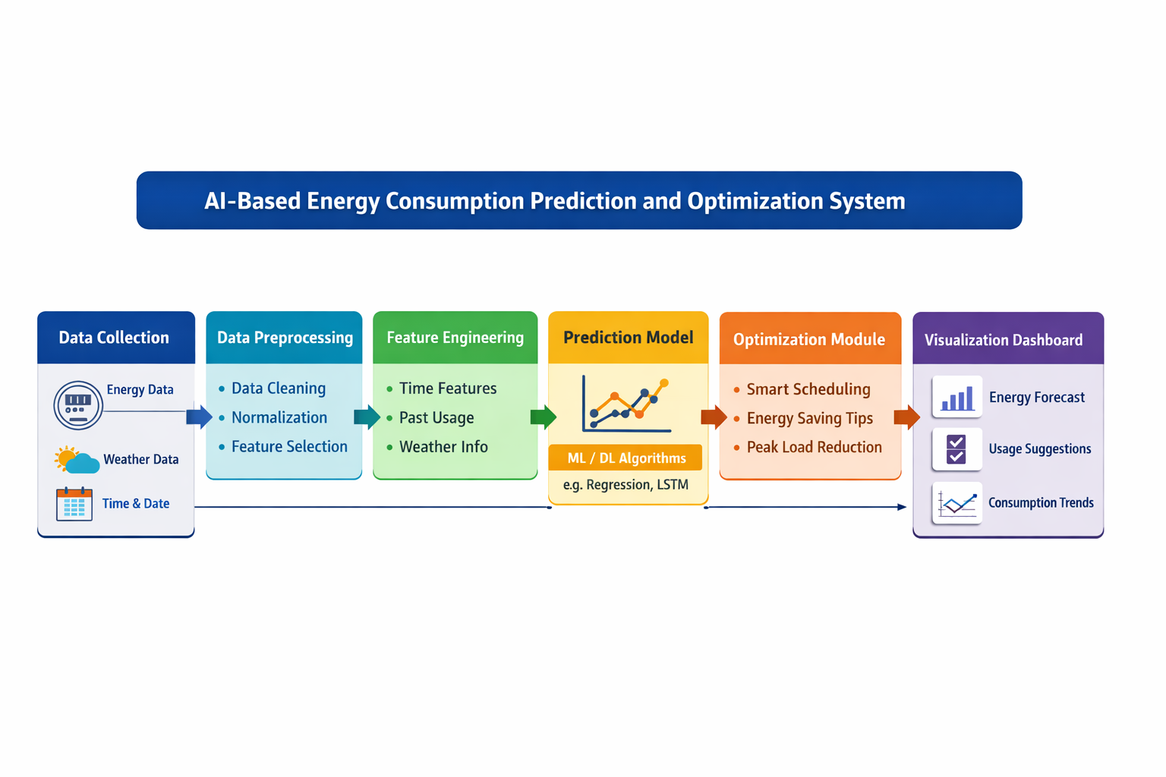
Block Diagram

Slide 10



Technology Stack
Programming Language: Python
Data Processing: NumPy, Pandas
Machine Learning: Scikit-learn
Deep Learning: TensorFlow, Keras
Data Visualization: Matplotlib
Development Tools: Jupyter Notebook, Google Colab
Dataset: CSV files / public energy datasets

Slide 11
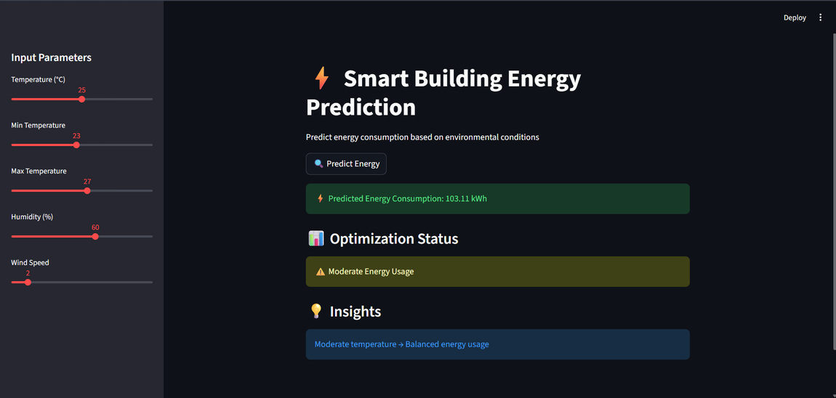
Result/Outcomes
📊 Accurate Energy Prediction
Successfully predicts future energy consumption using ML/DL models
📉 Reduction in Energy Wastage
Identifies unnecessary usage and helps minimize power loss
⚡ Peak Load Identification
Detects high energy consumption periods for better planning
💰 Cost Optimization
Helps in reducing electricity bills through smart usage
📈 Data Visualization
Displays energy usage patterns using graphs and dashboards
🤖 Intelligent Recommendations
Suggests optimal time and ways to use electrical appliances
🌱 Improved Energy Efficiency
Promotes sustainable and eco-friendly energy usage

Slide 12
Conclusion
The AI-Based Energy Consumption Prediction and Optimization System successfully demonstrates how intelligent techniques from Machine Learning and Deep Learning can be used to analyze historical energy data and predict future electricity consumption. The system provides useful insights into energy usage patterns and offers smart suggestions to optimize consumption.
By enabling accurate prediction and data-driven decision-making, the project helps in reducing energy wastage and lowering electricity costs. It also promotes efficient energy utilization without the need for complex hardware, making it a cost-effective and scalable solution.

Slide 13
Future Perspective
🌐 Integration with IoT Devices
Real-time data collection using smart meters and sensors
🏠 Smart Home Automation
Automatic control of appliances based on AI predictions
📱 Mobile Application Development
User-friendly app for monitoring and controlling energy usage
🤖 Advanced AI Models
Implementation of Deep Learning models like LSTM for better accuracy
⚡ Real-Time Optimization System
Automatic scheduling of devices to reduce peak load
🌆 Smart City Implementation
Large-scale deployment for efficient city-wide energy management
🔋 Renewable Energy Integration
Combine with solar and wind systems for sustainable energy usage
📊 Cloud-Based Dashboard
Remote monitoring and data storage using cloud platforms

Slide 14

Reference
[1] P. W. Khan, Y. Byun, and N. Park, “Machine Learning-Based Approach to Predict Energy Consumption of Renewable and Nonrenewable Power Sources,” Energies, vol. 13, no. 18, pp. 1–20, 2020.
[2] M. H. L. Lee, H. H. Tan, and C. K. Lee, “A Comparative Study of Forecasting Electricity Consumption Using Machine Learning Models,” Mathematics, vol. 10, no. 8, pp. 1–18, 2022.
[3] M. Qureshi, A. Khan, and S. Rehman, “Deep Learning-Based Forecasting of Electricity Consumption,” Scientific Reports, vol. 14, pp. 1–12, 2024.
[4] T. A. Abd’Azeez, A. O. Salau, and M. A. Adebayo, “Machine Learning-Powered Energy Consumption Prediction System with API,” Energy Informatics, vol. 8, no. 1, pp. 1–15, 2025.
[5] I. Hussain, M. Alghamdi, and K. Ahmad, “Evaluating Machine Learning Algorithms for Energy Consumption Prediction in Electric Vehicles,” Scientific Reports, vol. 15, pp. 1–14, 2025.
[6] D. Karthik and R. Kumar, “Electricity Consumption Prediction Using Machine Learning,” International Journal of Scientific Research in Science, Engineering and Technology, vol. 10, no. 2, pp. 296–301, 2023.
[7] N. Jain and S. Sharma, “Prediction and Analysis of Household Energy Consumption Using Machine Learning,” International Journal of Renewable Energy Research, vol. 12, no. 3, pp. 1–10, 2022.
Git HUB Button:

Slide 15
Thank You

